Slide 1
Relationship Between Socioeconomic factors and Health outcomes in Chicago
Ting Tsai
Sohyun Lim

Slide 2
Motivation and Research Question
Relationship between socioeconomic factors and health outcome
How socioeconomic factors and health outcomes are related to the location of healthcare centers in Chicago

Slide 3
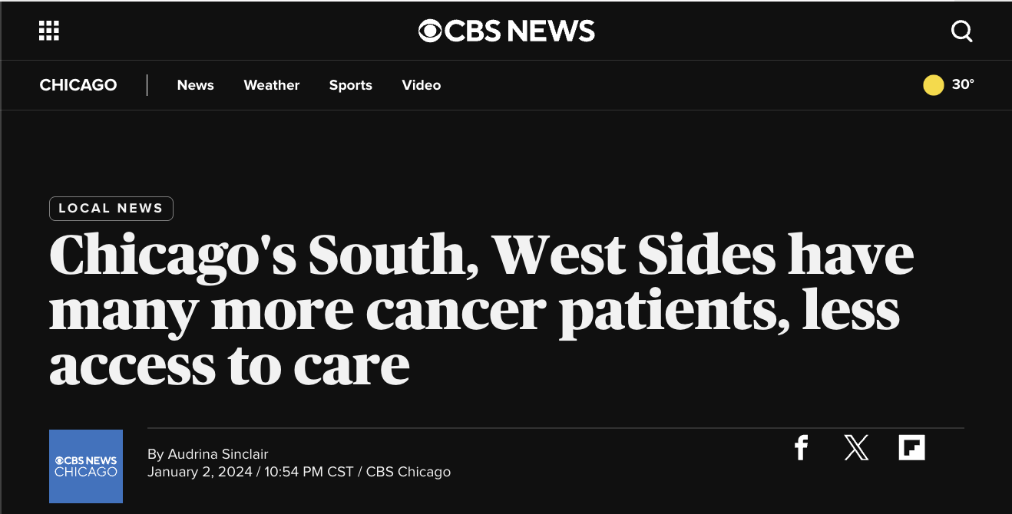
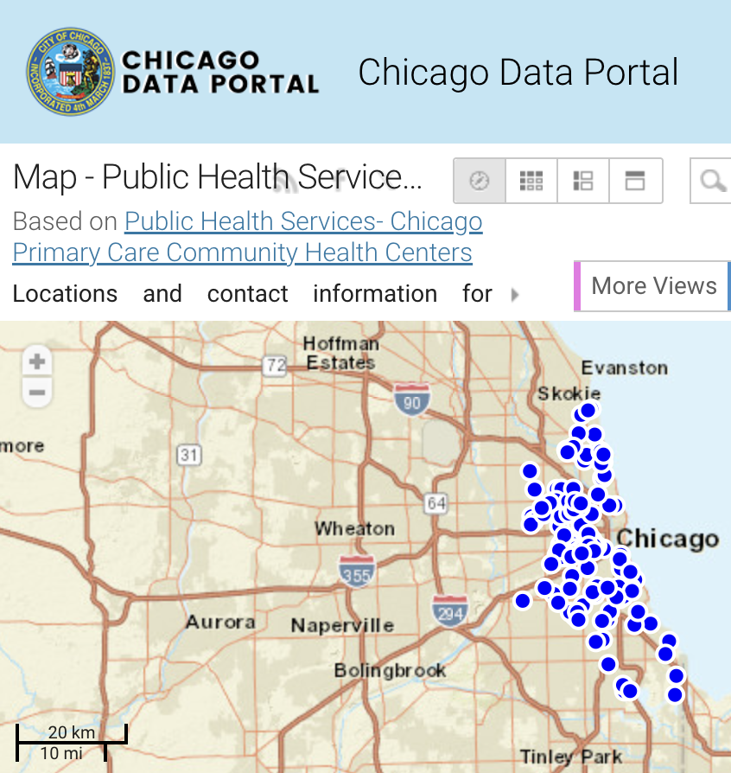
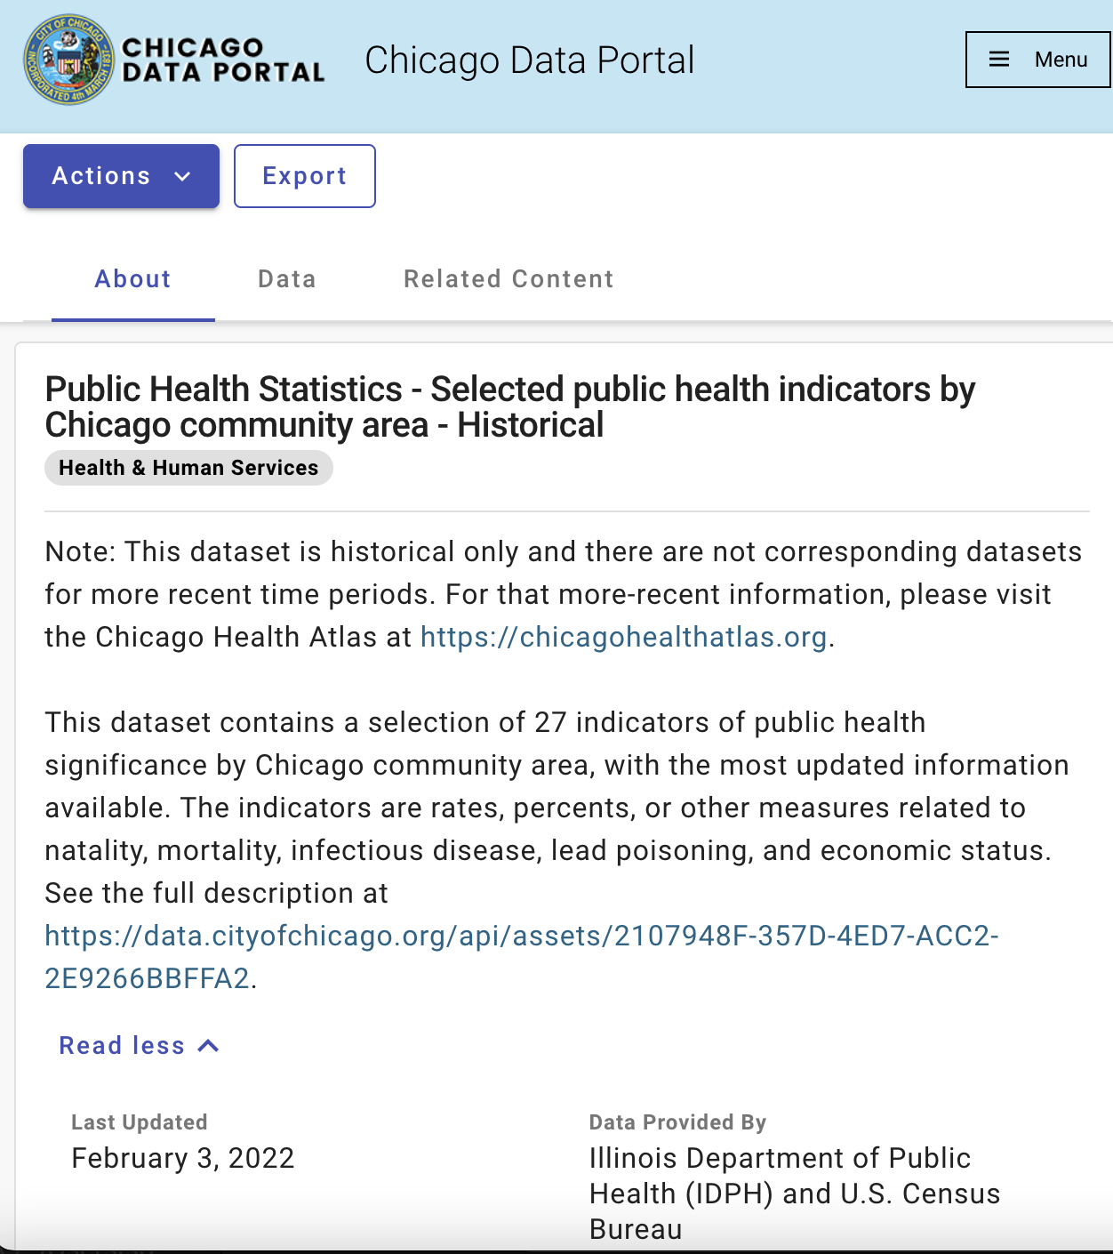
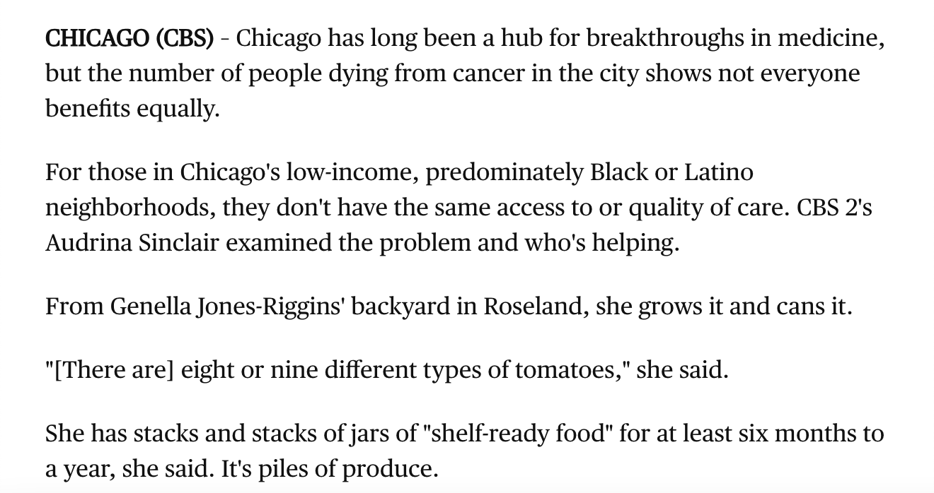
Data Resource
CBS News Article
Chicago Public Health Service Map
Chicago Public Health Statistics
Text Analysis
Geospatial Analysis
Linear Regression

Slide 4
Methods
Text Analysis
Descriptive statistics
Linear Regression
Geospatial Analysis

Slide 5
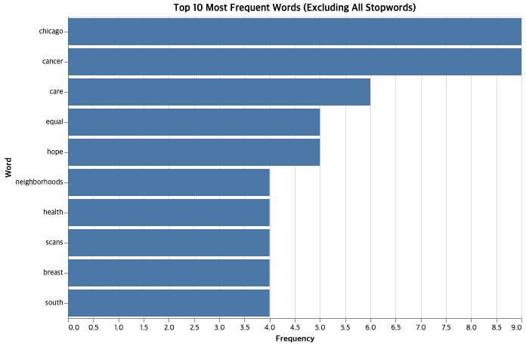
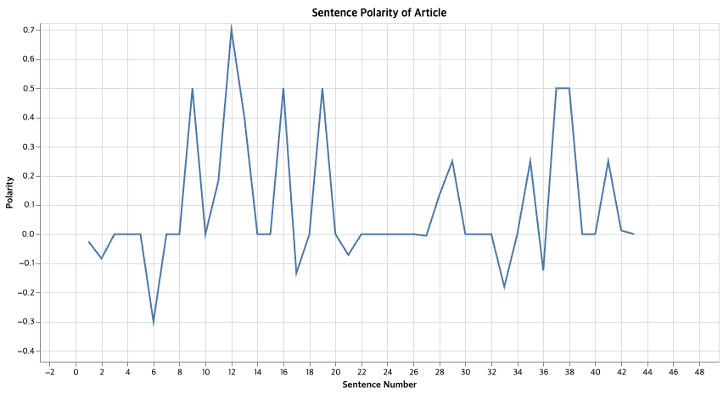
Text Analysis
Analysis | Outcome | Result
Polarity | 0.10 | Slightly positive
Subjectivity | 0.38 | Relatively objective
Figure 1. Frequency Analysis
Figure 2. Sentimental Analysis (sentence)

Slide 6
Basic Analysis
Top 10 Chicago Community Area by socioeconomic factors and health outcomes

Slide 7
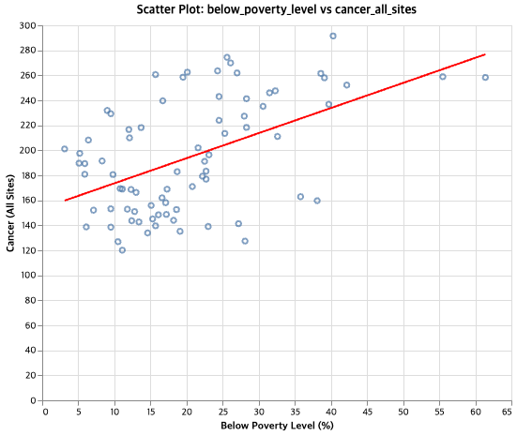
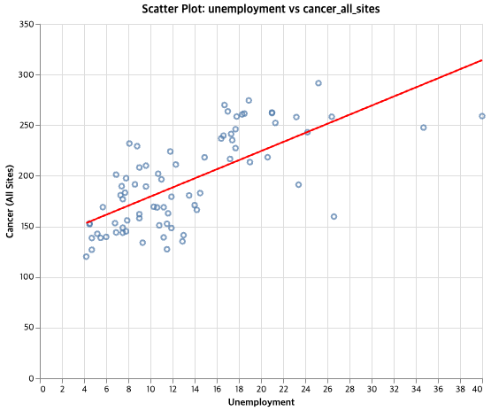
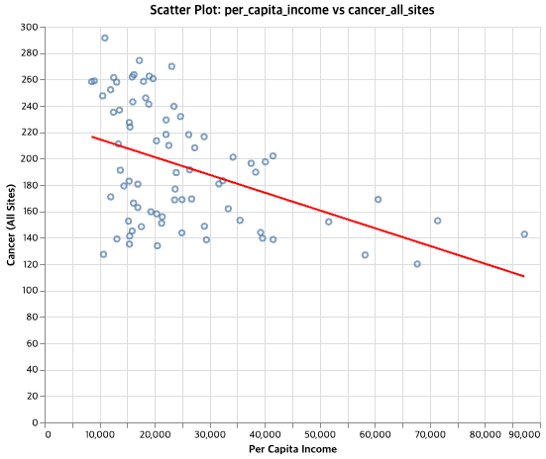
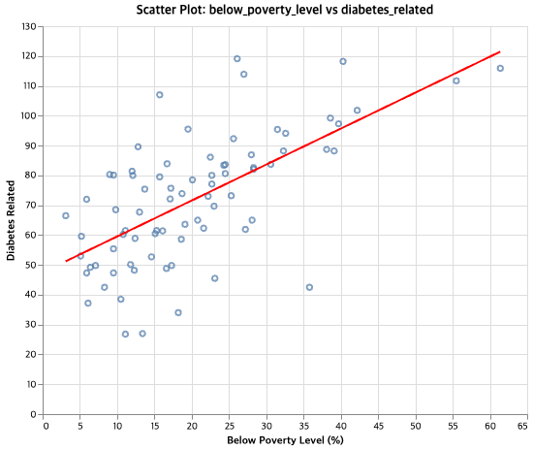
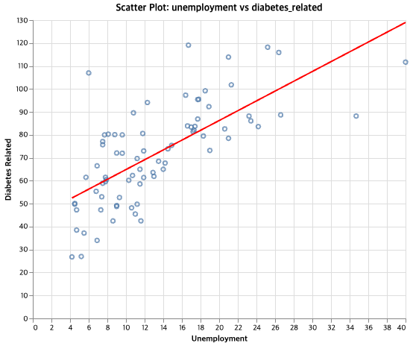
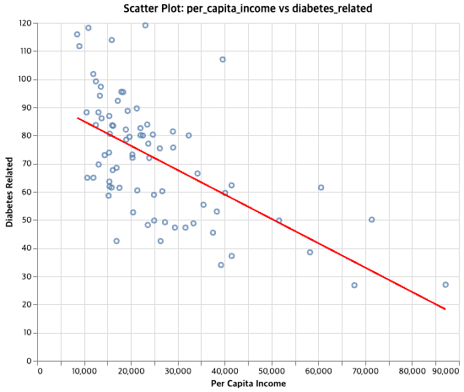
Regression Model

Slide 8
Geospatial Analysis

Slide 9
Shiny App Demo

Slide 10
Conclusion
Findings
Limitation
Next Steps

Slide 11
Thank you

